Slide 1
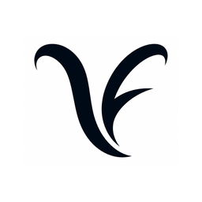
OPEN
Light load — everything gets through
KungFlow
Focus that protects your people.
LEARNING
Load rising — KungFlow is watching your back
KungFlow senses cognitive overload in real time and quietly blocks
interruptions — automatically. Healthier minds, deeper work.
PROTECTED
Overload — interruptions quietly blocked
Seed Round · 2026
Leeor Nessing · Ido Mark · Rotem Saraf · Eden Elkayam

Slide 2
THE TEAM
Built by people who lived the problem
LN
IM
RS
EE
Leeor Nessing
Ido Mark
Rotem Saraf
Eden Elkayam
Psychology & UX
Computer Science
Computer Science
Computer Science
research & strategy
Engineering
Engineering
Engineering
Why us? This problem sits exactly between cognitive psychology and software engineering — and so do we. We built KungFlow because notifications were burning our own working hours.
2

Slide 3

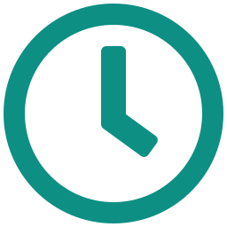

THE PROBLEM
You're in the zone — then the pings hit
56
23 min
Stress up
interruptions per workday
to regain deep focus
the hidden price of pings
Pings, messages and alerts — one every ~9 minutes
After every single interruption (Mark, UC Irvine)
Interrupted work raises stress, frustration & time pressure (CHI '08)
Feel that for a second — your focus shattering. Now multiply it across every employee. That's what it costs the company.
3

Slide 4
THE COST
It costs people. Then it costs money.
THE HUMAN COST
THE BUSINESS COST — 250-PERSON COMPANY
26% higher stress and lower job satisfaction among employees with more digital interruptions (Microsoft)
12B working days lost globally every year to depression & anxiety — a $1T productivity bill (WHO)
$30M total payroll for 250 employees, every year
~5% of it — $1.5M+ — lost to interruptions (~2 hrs per person, daily)
Chronic interruption load is a direct driver of workplace stress and burnout.
Salary $10K gross/mo · employer cost ~$75/hr — money you already spend.
The good news: wellbeing pays. Every $1 invested in employee mental health returns ~$4 in health and productivity (WHO).
4

Slide 5

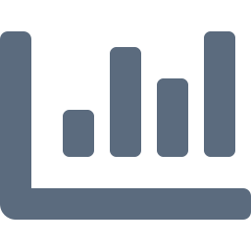
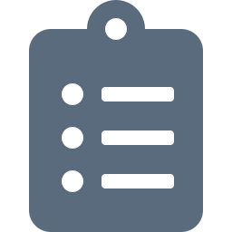

THE GAP
Plenty of fixes. None act in time.
Manual Do-Not-Disturb
THE GAP
Asks an overloaded brain to notice it's overloaded — exactly when it can't.
No tool detects overload and acts on it — automatically, in real time, with zero effort from the employee.
Time trackers (RescueTime, Toggl)
Report the damage after it's done. A speedometer, not a seatbelt.
Company focus-hour policies
One-size-fits-none. Not personal, not enforced, quietly resented.
Wellness apps (Calm, Headspace)
That's the product we built.
Lovely — but they live outside the workflow where the damage happens.
5

Slide 6




THE SOLUTION
KungFlow — a firewall for your focus
1 · SENSE
2 · UNDERSTAND
3 · PROTECT
Reads behavioral rhythm only — typing speed, window switches, mouse motion. Every minute, silently.
Scores cognitive load against your personal baseline. It learns what “normal” means for you.
Load exceeds 125% of baseline? DND on, WhatsApp & Outlook muted. Load drops? Everything back. Automatically.
No buttons. No willpower. No new habits. The employee just works — KungFlow guards the door. Desktop agent (Windows) + Chrome extension, live today.
6

Slide 7
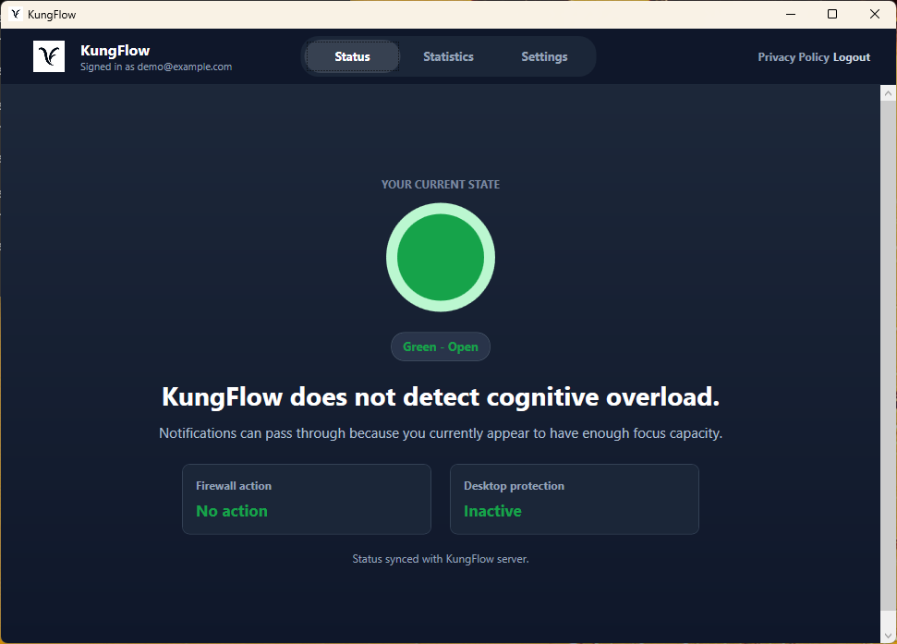
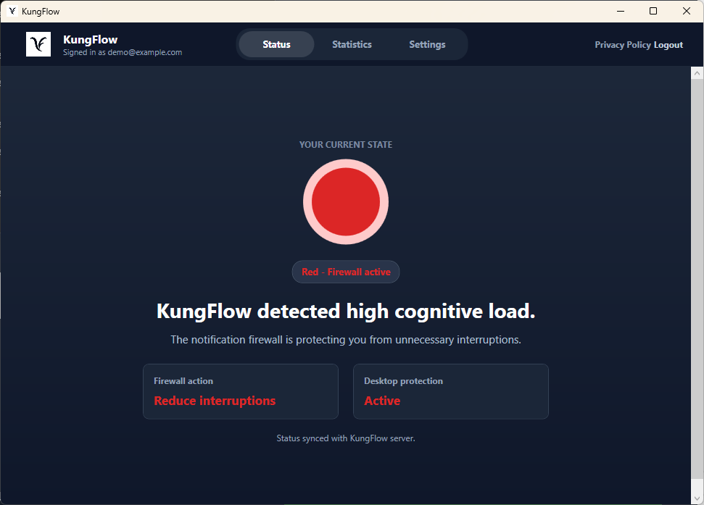
THE PRODUCT
Live on Windows today
Light load — everything gets through
Overload detected — firewall on, quiet restored
First working version — desktop agent + Chrome extension + cloud scoring — running live on Windows today. Full walkthrough available after the pitch.
7

Slide 8


TRUST BY DESIGN
Not surveillance. The opposite.
KUNGFLOW NEVER SEES
56% vs 40%
of digitally monitored employees feel tense or stressed at work, compared to non-monitored peers (APA, Work in America 2023).
What you type
Websites you visit
Documents you open
Screenshots — of anything, ever
IT ONLY SENSES RHYTHM
Typing speed & window switches — signals your OS already has
Surveillance backfires. So we flipped the model: the data belongs to the employee and works for the employee. KungFlow is a perk, not a watchdog.
All signals are anonymized and aggregated — managers see team trends only, never an individual's score.
Every employee can pause data collection. One toggle, no questions.
8

Slide 9
VALIDATION
We tested it. Focus won.
Task accuracy — error-correction task, score out of 20
+165%
better task scores once interruptions were removed
49%
fewer errors missed in the same 10-minute window
+25%
net gain after controlling for natural learning effects
Controlled pilot, n=8, with a learning-effect control group (2026). Larger study planned with design partners.
9

Slide 10
IMPACT
The math for one 250-person company
$1.5M
$90K
16 : 1
vs
=
recovered at just 5% of payroll
for KungFlow — 0.3% of payroll, all 250 seats
return on every $1 spent — and you add no real spend
AND FOR EVERY SINGLE EMPLOYEE
~2 hrs
56 → quiet
Calmer days
of deep work back, daily
interruptions blocked at the right moment
less stress, lower burnout risk
10

Slide 11
MARKET
A big problem — and an empty category
TAM
SAM
SOM Y1
1.2B
400K
2,500
knowledge workers worldwide
tech workers in Israel — our beachhead
users across 10 mid-market companies
Acts automatically, in real time?
RescueTime
Calm for Business
MS Viva Insights
Built-in DND
KungFlow
reports after the fact
outside the workflow
org dashboards only
needs the user to act
detects & protects on its own
11

Slide 12
BUSINESS MODEL
SaaS that climbs the org chart
Free
Team
MOST POPULAR
Enterprise
Business
$0 forever
$20 /user/mo
$30 /user/mo
$45+ /user/mo
For individuals
Everything in Free, plus
Everything in Team, plus
Everything in Business, plus
• Live cognitive-load score
• Adaptive personal baseline
• Team focus analytics
• Org burnout-risk analytics
• Auto-DND · 1 device
• All apps + all devices
• Custom & VIP rules
• AI recap of missed pings
• 7-day focus history
• Unlimited history + dashboard
• Admin console + onboarding
• SSO/SAML · CSM + SLA
For individuals · real focus protection, free
The power user · it learns you & covers every app
The manager · a whole team in deep work, with visibility
HR + IT · org-wide rollout, security & support
Bottom-up by design: free individual → paid team → manager → org, no new sales motion. ACV $90K · LTV:CAC 11:1 · 3-yr retention
12

Slide 13
THE ASK
$770K seed — break-even in 12 months
USE OF FUNDS
YEAR-1 MILESTONES
R&D — Scale & v2 development
M3
2 design partners live, feeding real usage data
57%
Marketing
M4
First paying company — revenue starts
18%
Customer success
M6
First SDR hired, outbound machine running
12%
Sales (SDR from M6)
M9
Public case study with measured results
12%
Infrastructure
M12
10 companies · 2,500 users · $900K ARR · break-even
1%
Covers 12 months of operations ($550K deficit) + 3-month buffer. One goal: 10 mid-market companies.
13

Slide 14
GTM STRATEGY
Product-led growth: free spreads, value sells
1 · ADOPT
2 · CONVERT
3 · EXPAND
4 · STANDARDIZE
Free, bottom-up
Free → Team
Team → Business
→ Enterprise
Individuals install the free tier and get real focus value — zero friction, no buyer needed. It spreads desk to desk.
Power users self-upgrade for the adaptive baseline and all their apps. Pure self-serve — no salesperson in the loop.
Managers see their team already using it and buy team analytics, admin and custom rules. Light sales-assist.
HR and IT roll it out org-wide — SSO, burnout analytics, dedicated CSM. Top-down lands on bottom-up demand.
Free does the selling. The product expands itself up the org chart — low CAC, fast payback, and it compounds as every free user pulls the next one in.
14

Slide 15
GO-TO-MARKET
How we reach companies
PHASE 1 · M1–3
PHASE 2 · M4–6
PHASE 3 · M6–12
THEN
Design partners
Founder-led sales
Scale outbound
Expand outward
2 companies from our own network, installed free — in exchange for feedback and case-study rights.
We sell directly. LinkedIn outreach to VP R&D and VP People at Israeli tech, 100–500 employees.
First SDR at M6. 40 sequences/week. Public case study at M9 with measured results.
Land & expand inside each account, then US via Israeli logos with US offices, then Europe (GDPR).
Why Israel first: warm founder network, demanding early adopters, and short sales cycles keep CAC low — and Israeli logos open doors in the US.
15

Slide 16
Thank you.
Let's give people their focus back.
KungFlow · Leeor Nessing · leeorn@gmail.com

